Slide 1
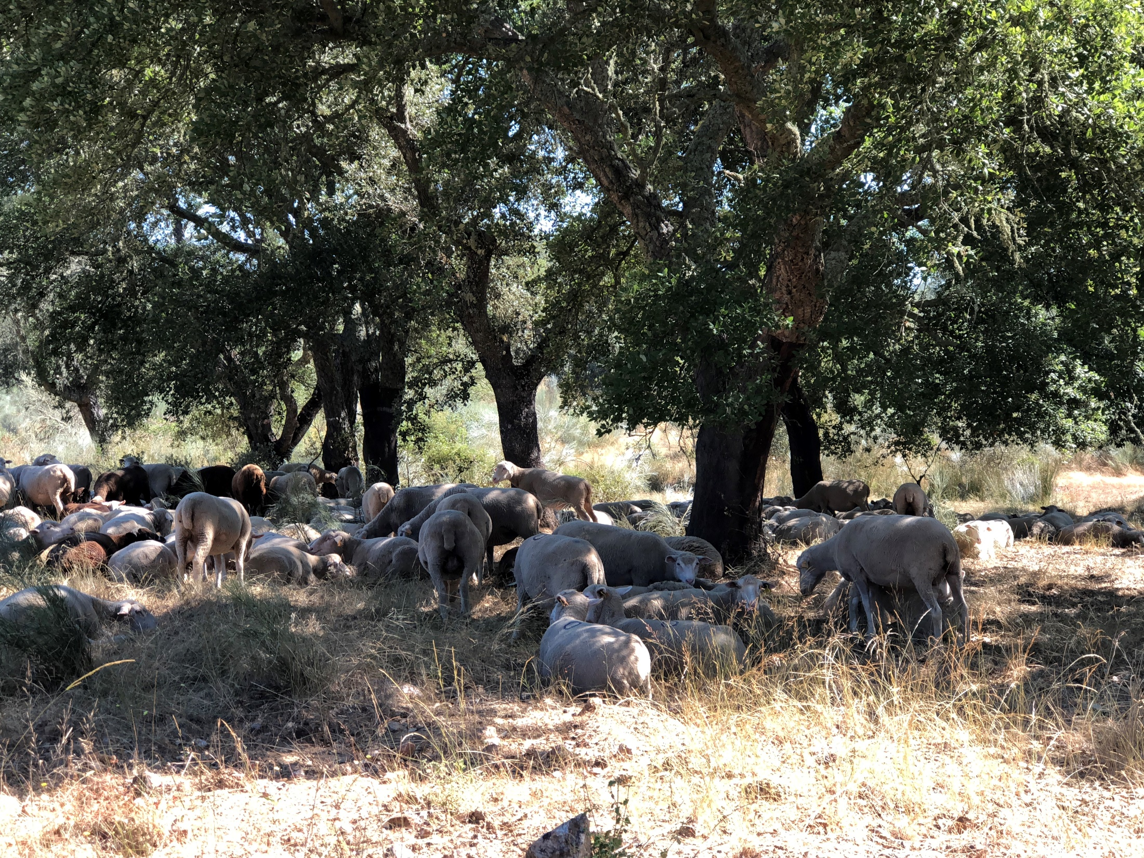
Site quality, site index curves (SIC) and dominant height growth
Margarida Tomé, Susana Barreiro
Instituto Superior de Agronomia
Universidade de Lisboa

Slide 2
Summary
What is the site and the site quality?
How can we evaluate site index?
Data available for developing site index curves (SIC)
a) Temporary plots
b) interval and permanent plots,
c) stem analysis
Types of site index curves:
Anamorphic
Polymorphic
Indirect methods for the development of site index curves
Direct methods to estimate S

Slide 3
Site and site quality
What is the site?
Site refers to “an area considered in terms of its environment, particularly as this determines the type and quality of the vegetation the area can carry”
(Society of American Forests 1971)
Site quality can be evaluted through direct and indirect methods
Direct or geocentric methods – site is evaluated by climate and soil characteristics
Indirect or phytocentric methods – site is evaluated by the analysis of the vegetation growing in the site
Indicator plants (namely shrubs)
Site índex [ f= (hdom, t) ]
Site índex [ f= (climate, soil) ]

Slide 4
Site and site quality
What is the site?
Site refers to “an area considered in terms of its environment, particularly as this determines the type and quality of the vegetation the area can carry”
(Society of American Forests 1971)
Site quality can be evaluted through direct and indirect methods
Direct or geocentric methods – site is evaluated by climate and soil characteristics
Indirect or phytocentric methods – site is evaluated by the analysis of the vegetation growing in the site
Indicator plants (namely shrubs)
Site índex [ f= (hdom, t) ]
Site índex [ f= (climate, soil) ]

Slide 5
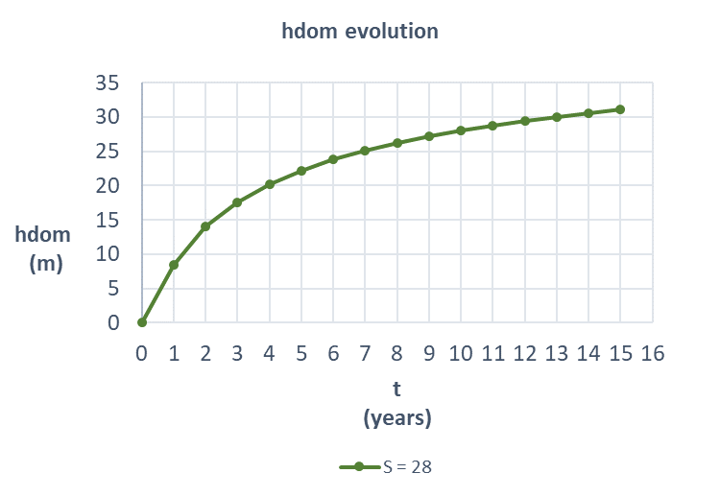
Using Site Index [ f= (hdom, t) ] to evaluate site quality
Assessing the productive potential is essential for forest management.
For modelling purposes site quality has to expressed by a number, be objective and easily determined
What could be a measure of site quality?
Volume production is no feasible measure of site quality:
Limited historic data available
Not easily determined in forest practice
Stand density dependent
Stand dominant height development has been widely used to assess site index

Slide 6
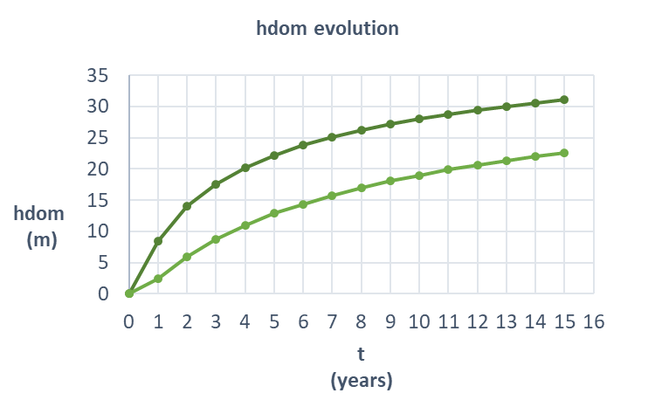
Using Site Index [ f= (hdom, t) ] to evaluate site quality
Assessing the productive potential is essential for forest management.
For modelling purposes site quality has to expressed by a number, be objective and easily determined
What could be a measure of site quality?
Volume production is no feasible measure of site quality:
Limited historic data available
Not easily determined in forest practice
Stand density dependent
Stand dominant height development has been widely used to assess site index

Slide 7
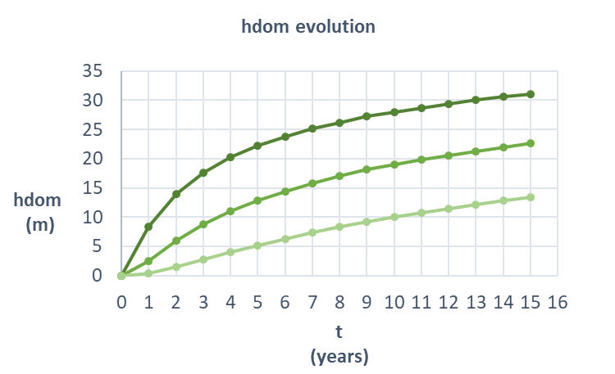
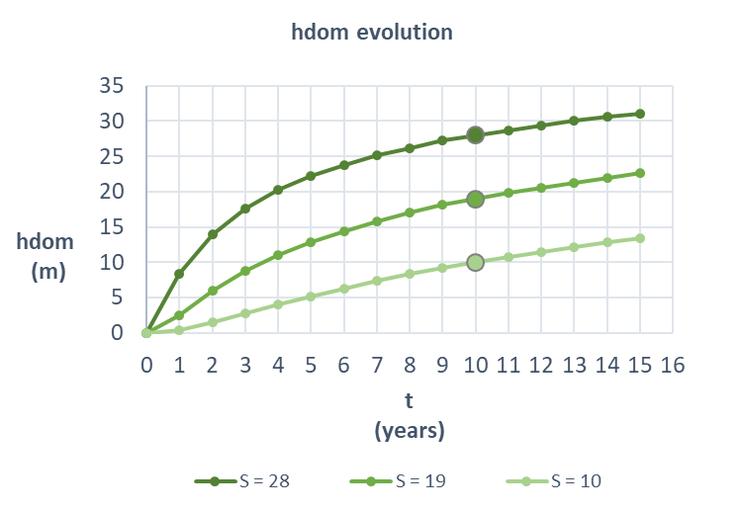
Using Site Index [ f= (hdom, t) ] to evaluate site quality
Assessing the productive potential is essential for forest management.
For modelling purposes site quality has to expressed by a number, be objective and easily determined
What could be a measure of site quality?
Volume production is no feasible measure of site quality:
Limited historic data available
Not easily determined in forest practice
Stand density dependent
Stand dominant height development has been widely used to assess site index
S (site index) is the hdom (dominant height) at a chosen t (age)

Slide 8
Using Site Index [ f= (hdom, t) ] to evaluate site quality
Site index (S) is defined as the dominant height that the stand has, had or will have at a certain age, the base age
Therefore, the simulation of dominant height growth is intimately related with the prediction of site índex
The site index concept assumes that the dominant height is not affected by silvicultural treatments
The set of curves that represent dominant height growth for the range of possible site indices is know as site index curves (SIC) -> families of growth curves

Slide 9
Using Site Index [ f= (hdom, t) ] to evaluate site quality
Site index curves may be built with different types of data:
a) temporary plots - Independent data pairs (hdom, t)
b) permanent and/or interval plots - successive data pairs (hdom, t)
c) stem analysis techniques – reconstruct height growth data of individual trees

Slide 10
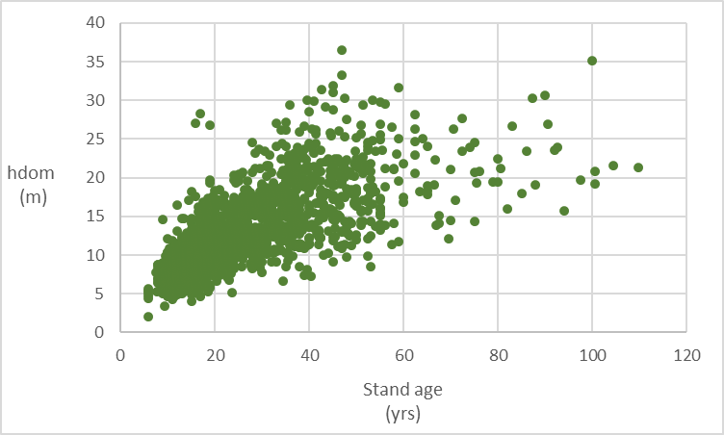
Building SIC – data that can be used
Using Site Index [ f= (hdom, t) ] to evaluate site quality
a) Temporary plots - Independent data pairs (hdom,t) from
In order to avoid biased site index curves, it is important to guarantee that all the site index classes are equally represented in the data set
Correlations between site index and stand age are often found
(e.g. more fertile sites were first planted) and, if this is the case, the site index curves will be influenced by this relationship

Slide 11
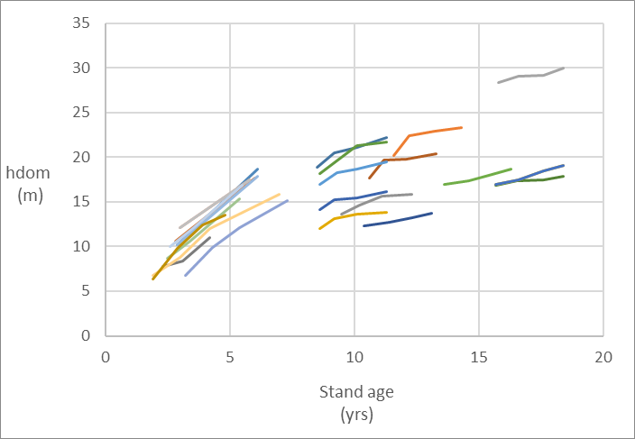
Building SIC – data that can be used
Using Site Index [ f= (hdom, t) ] to evaluate site quality
b) Interval and/or permanent plots - successive data pairs (hdom,t)
The set of remeasurements from the same plot is usualy designated by “growth series”
This is the prefered data to develop site index curves as it allows the identification of the real growth shape
It is important to have data that give a good representation of all the ages, covering all the growth stages, from juvenile to senescency
Each colored line represents the measurements carried out in one plot

Slide 12
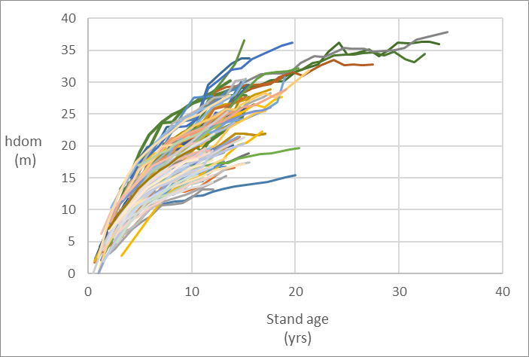
Building SIC – data that can be used
Using Site Index [ f= (hdom, t) ] to evaluate site quality
b) Interval and/or permanent plots - successive data pairs (hdom,t)
The set of remeasurements from the same plot is usualy designated by “growth series”
This is the prefered data to develop site index curves as it allows the identification of the real growth shape
It is important to have data that give a good representation of all the ages, covering all the growth stages, from juvenile to senescency
Each colored line represents the measurements carried out in one plot

Slide 13
Building SIC – data that can be used
Using Site Index [ f= (hdom, t) ] to evaluate site quality
c) Stem analysis
This method applies only in the temperate zones and with tree species characterized by well defined growth rings
One has to assume that the dominant trees at the age of harvest have been the dominants during the whole life of the stand
Tennent and Burkhart (1981) found out that the stem analysis could be restricted to 2 dominant trees with d close to ddom and the heights within the interval hdom ±5%

Slide 14
Using Site Index [ f= (hdom, t) ] to evaluate site quality
The existing methods for SICs development can be grouped as follows:
i) Guide-curve method
ii) Parameter prediction method
iii) Difference equations
$$hdom=S e^{−14.2234 \left(1/t − 1/{40}\right)}$$
$$hdom=S \frac{1−e^{{\left(b_{0} S t\right)}^{b_{1}}}}{1−e^{{\left(b_{0} S t_{b}\right)}^{b_{1}}}}$$
Detailed information on each method can be found in the Growth Functions PowerPoint
$$hdom=A {\left(\frac{S}{A}\right)}^{{\left(\frac{t_{b}}{t}\right)}^{m}}$$

Slide 15
Using Site Index [ f= (hdom, t) ] to evaluate site quality
Limitations:
Exact stand age is often difficult to determine in field situations, and small errors can cause large changes in the site index estimate
Concept of site index is not suitable for uneven-aged stands
Site index alone may not provide a valid estimate of the growing capacity for a particular site
Site index may change due to environmental and climatic variations or management activities
Site index for one species can not be translated into a usable index for a difference species on the same site
So…

Slide 16
Using Site Index [ f= (climate, soil) ] to evaluate site quality
Site índex estimates when age is unknown (examples):
1. Pinus pinaster in Portugal (Marques, 1991):
1.a) S = f (topographic, edaphic, climate) (R²=0.544)
1.b) S = f (species in the understory) (R²=0.144)

Slide 17
Using Site Index [ f= (climate, soil) ] to evaluate site quality
Site índex estimates when age is unknown (examples):
2. Pseudotsuga menziesii in Portugal (Fontes et al., 2003):
.
2.a) S = f (region, topographic, edaphic, climate )
SAxMAxAM – ecological regions in Portugal (Pina Manique e Albuquerque, 1954 )
MinhoLitoral - dummy variable for region (0,1), 1 if located Minho Litoral
2.b) …

Slide 18
Using Site Index [ f= (climate, soil) ] to evaluate site quality
Site índex estimates when age is unknown (examples):
3. Quercus suber in Portugal (Paulo et al., 2015):
3.a-c) S = f ( topographic, edaphic )
Soil depth - requires opening a soil profile and improves the quality of the model substantially
Insolation - the amount of solar radiation reaching a given area

